Slide 1

What-a-Crypto
Team Members
Rafael ● Matthew ● Jesus ● Carlos ● Yen

Slide 2
Have you been wanting to try crypto trading but do not feel confident enough to trade with your own hard earned money? Our team at What-a-Crypto has created a tool to help you practice the basics of crypto trading in a fun interactive game. We use real historic data for you to learn how to read the market, allowing you to build confidence and knowledge in a risk free setting.
Notes:
jesus

Slide 3
Description
The site provides a gamified approach to learning about crypto currency exchanges. It collects historical data from a random date, in 15 minute intervals. The date chosen was more than 180 days back but no more than a year old. The 15 minute intervals are then passed off as a single second of game time. This creates the illusion of the entropy associated with buying and subsequently selling crypto. From the experience, the user then gets the opportunity to navigate the site and see all of our offerings.
Notes:
rafael

Slide 4
Motivation
Our motivation for the website was to test our coding abilities so far and to promote safe stock market purchases.
We wanted to test our limits of how we can create a fun and interactive website that you can practice and actually build good buy-low and sell-high stock sills. We kept ourselves motivated and powered through this project together.
Notes:
michael

Slide 5
User Story
As someone who is interested in getting in the field of buying and trading cryptocurrency, but is uneducated and a little skeptical, I would like to find a website or application that will allow me to purchase and sell crypto-risk free, in order to familiarize myself with the process and develop the confidence to start purchasing and selling in the real world.
Notes:
carlos

Slide 6
Technologies Used
HTML
CSS
Javascript
Bulma Framework
Google Firebase Firestore
API (coinapi.io and type.fit/api/quote)
Notes:
yen

Slide 7
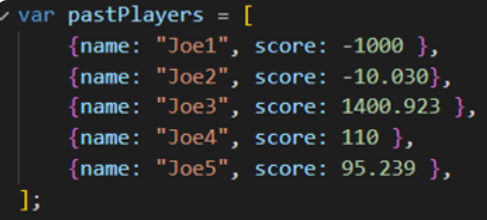
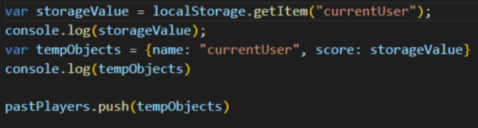
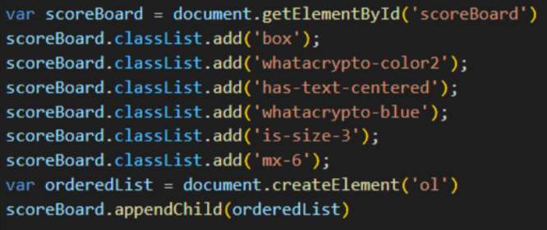
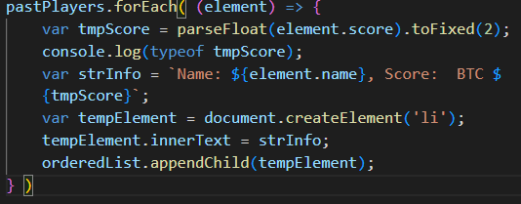
Matthew
The high scores page uses local storage data, an object array, and a sorting method.
Arcade style
There are 5 random score players that were created through an object array. They have a name and value.
Then created a local storage variable named “storageValue”, that retrieves the user’s score and then pushes the score into the array using the “TempObjects”.
And now after the values have been stored, we can sort them from greatest to least. “The orderedList” variable is set to an ordered list into a div. CSS is then added. Finally, I set the array forEach to have a name and value element and this would be written to the page in a list.

Slide 8

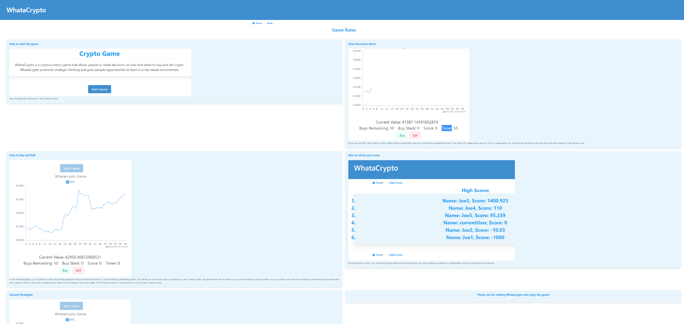
Carlos
Created the Rules Page
Share Links for social media at bottom

Slide 9
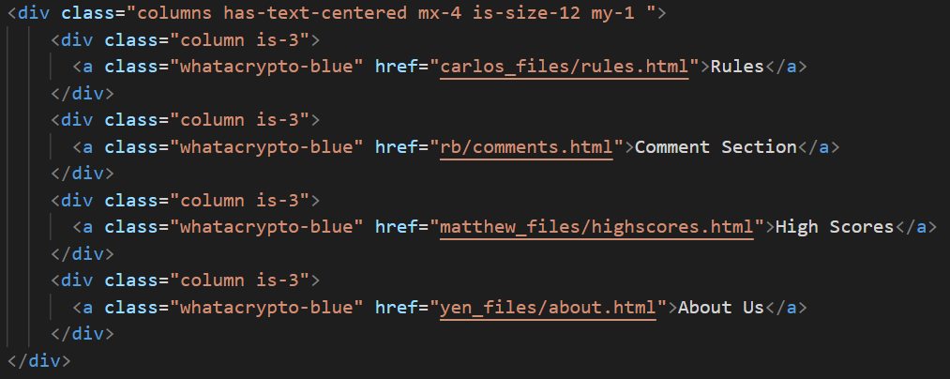
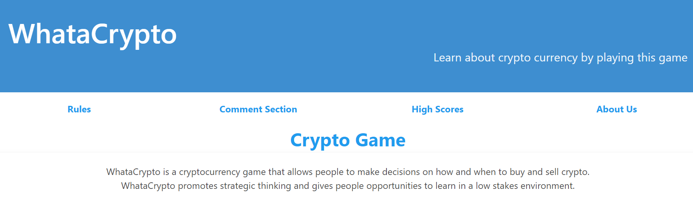
Jesus
I was in charge of the main page for the website. My task was to make it look desirable and inviting, using good color schemes and a modern design. The styling program we decided to use was Bulma, a great choice especially since the tools included a wide variety of elements, colors and special characters. Along with this I was also in charge of making links for the other pages my team members were creating, inside of a navigation bar. It was quite pleasurable being able to showcase my skills using what I’ve learned so far and some of my prior knowledge.

Slide 10
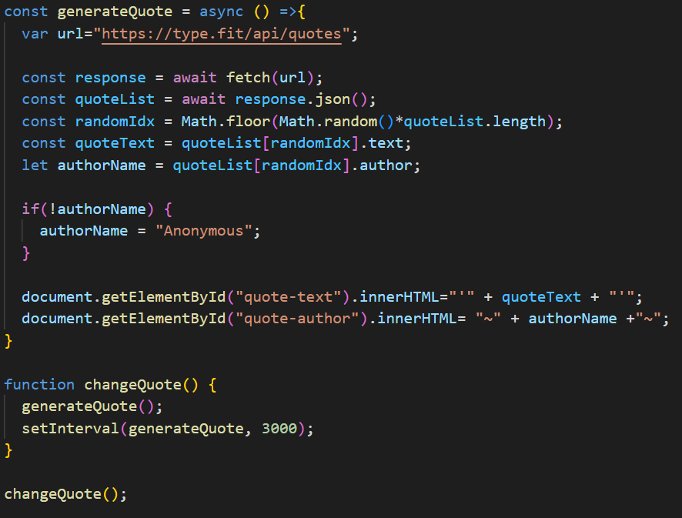
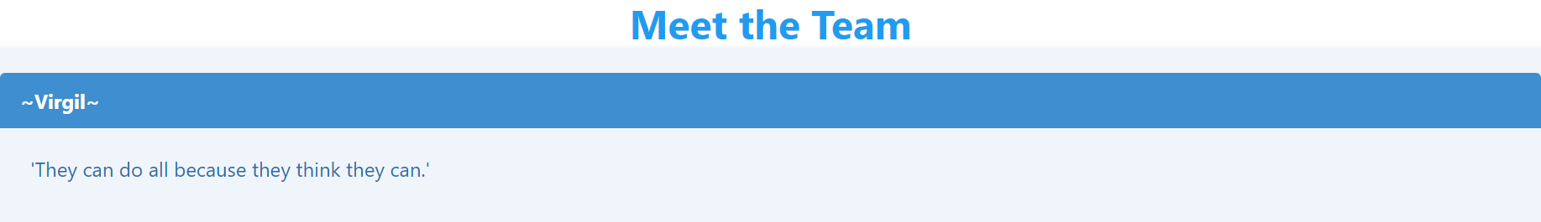
Yen
I was in charge of the About Us page. I added every team member photos with short bio. The most exciting thing I did on the page was implementing the quote api to the top of the page. It generates a new random quote every 3 seconds.

Slide 11
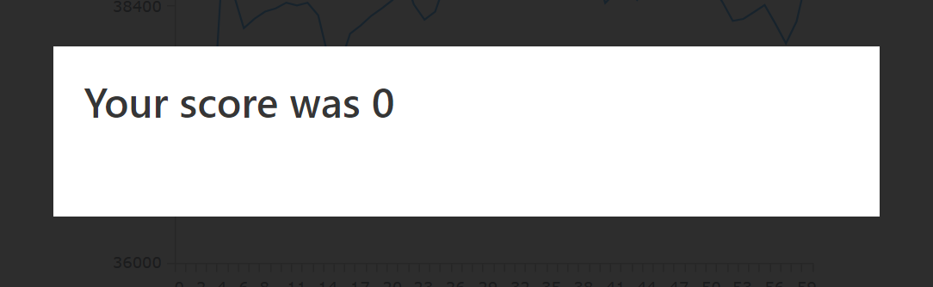
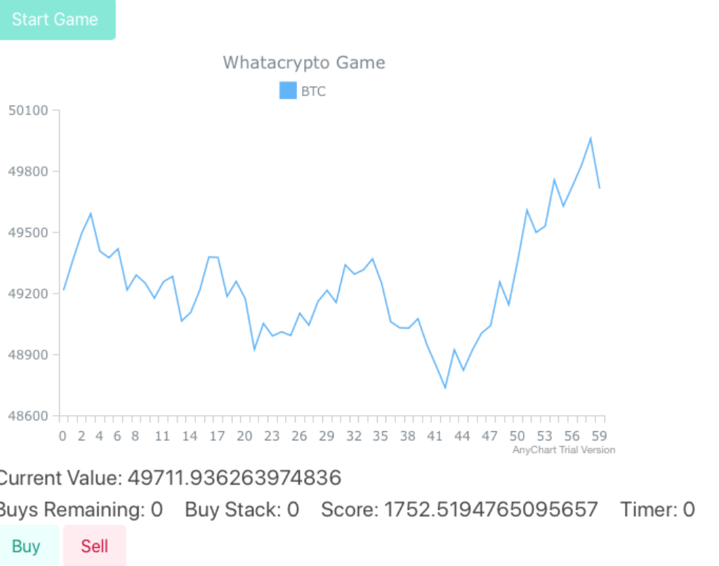
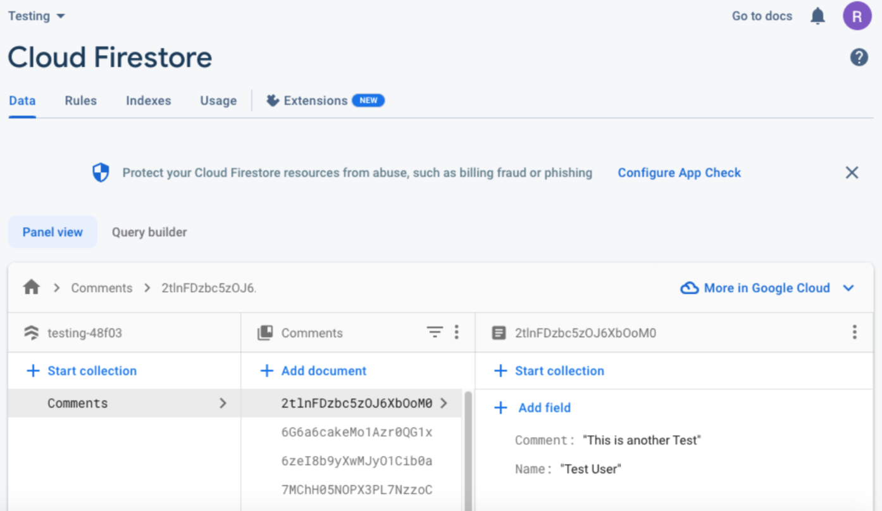
Rafael

Slide 12
Demo

Slide 13
Challenges
There was an external problem with the actual value of crypto currency. The problem being that the real world value for this currency has decreased dramatically. As a result, it took a lot of trial and error, to get to a query time interval that could be used in order to give players a fair chance
The charting JavaScript Library (AnyChart.js) is used in trial mode. This means that it comes with a watermark logo, and I can not stop the animation if the game finishes early.
Combining the fetch request promise with the chart display created a delay in the beginning of the game. This delay can be up to a second long.
Git Merge de-conflicting only checks lines of code and not logic.
Notes:
rafael

Slide 14
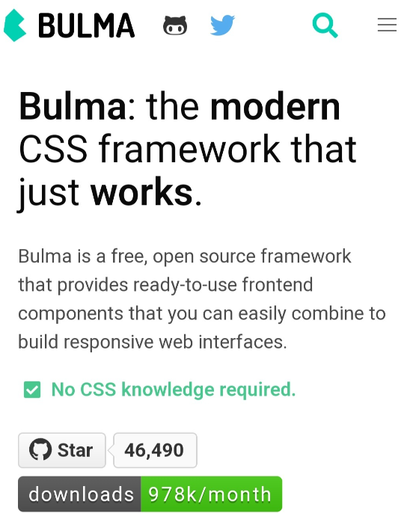
Successes
On top of individual successes from each member, our collective decision to use Bulma as the CSS framework was one that allowed us to easily make our webpage very eye-catching.
Bulma made it simple for us to style every webpage using the same color schemes, headers, boxes, columns, icons, font, buttons by appending modifier classes. Bulma also made the pages responsive without much effort on our end.
Notes:
yen

Slide 15
Directions for Future Development
Expand the ability to trade other cryptocurrency beyond Bitcoin
Expand the ability to trade using other currency beyond the USD
Add feature to give users the ability to change the setting of the game
Redesign the web app with a different API, in order to fetch real-time data (as opposed to historical data)
Redesign the charting using D3.JS or WebGL in order to create a more customizable experience
Notes:
yen

Slide 16
Links
Deployed: https://rbarbosa51.github.io/whatacrypto-crypto-game/index.html
GitHub Repo: https://github.com/rbarbosa51/whatacrypto-crypto-game

